Slide 1
Cultivating a Healthy Workplace:
The Key to Healthier Employees
Jennifer Pferrer, Executive Director
Wellness Council of Indiana
Indiana Chamber of Commerce

Slide 2
About Us
501(c)(3) Organization
Subsidiary of the Indiana Chamber of Commerce
Workplace and Community Well-Being
Member Organization
Notes:
The Wellness Council of Indiana is a 501(c)3 not-for-profit organization and subsidiary of the Indiana Chamber of Commerce. Through this partnership, we take a workforce and economic development-approach to employee health and well-being. We view strong well-being efforts as a strategic business practice to help recruit and retain top talent.
We work with workplaces and communities throughout the state to develop, maintain and evolve their strategic well-being strategies.
We meet our member organizations where they are and guide them in their own unique well-being journey. We are proud to work with over 1400 member organizations throughout the state.

Slide 3
Our Goal
To improve the quality of life for Indiana residents by empowering employers and communities to create thriving places to live, work, learn and play through connection, collaboration, education and evaluation.

Slide 4
Membership
PROGRAMS
AchieveWELL
Indiana Healthy Communities
Quit Now
EMPLOYER SOLUTIONS
Mental Health First Aid
Member Resource Center
Well-Being Strategy Consultations
BEST PRACTICE SHARING
Mental Health Guidance
Monthly Webinars and Trainings
Employer Convenings
Mentorship
ANNUAL WELLNESS SUMMIT
Connect with professionals to share challenges, successes and best practices
Notes:
Members receive recognition, best practice sharing, employer solutions and opportunities to convene with other wellness professionals from throughout the state.

Slide 5
Indiana Health Metrics
An Overview of Key Health Indicators in Indiana

Slide 6

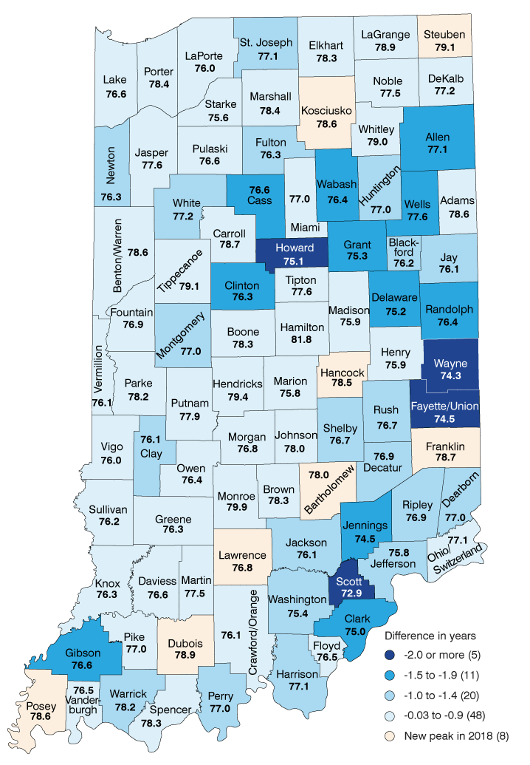
In Indiana, the average life expectancy was 76.5 years.
This ranged from
71.5 to 81.6 years across counties in the state.
Jefferson County 75.8 years
CDC average life expectancy for US 80.0 years
Women tend to live longer than men. American men expect to live an average of 76.1 years, while women expect to live an average of 81.1 years, a five-year difference.
The 2023 County Health Rankings used data from 2018-2020 for this measure.

Slide 7
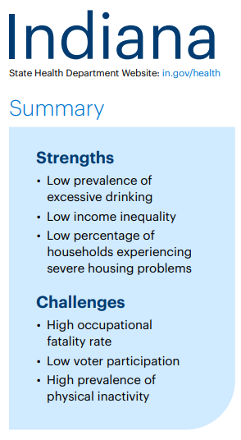
Indiana’s Overall Health Ranking
Indiana ranks #35 out of 50 states in overall health
Includes the following measures:
  Social and economic factors
  Physical Environment
  Clinical Care
  Behaviors
  Health Outcomes
Notes:
2023 Annual Report | AHR (americashealthrankings.org)
Social and economic factors include: Community and family safety, economic resources (economic hardship index, food insecurity, income inequality), education, social support and engagement
Physical Environment includes: air and water quality, climate and health, housing and transit
Clinical Care includes: Access to care, preventive clinical services, quality of care
Behaviors include: Nutirtion & physical activity, sexual health, sleep health, tobacco use
Health outcomes include: Behavioral health (drug deaths, excessive drinking, frequent mental distress, non-medical drug use), Mortality (premature death), and Physical health (frequent physical distress, low birth weight, multiple chronic conditions, obesity)

Slide 8
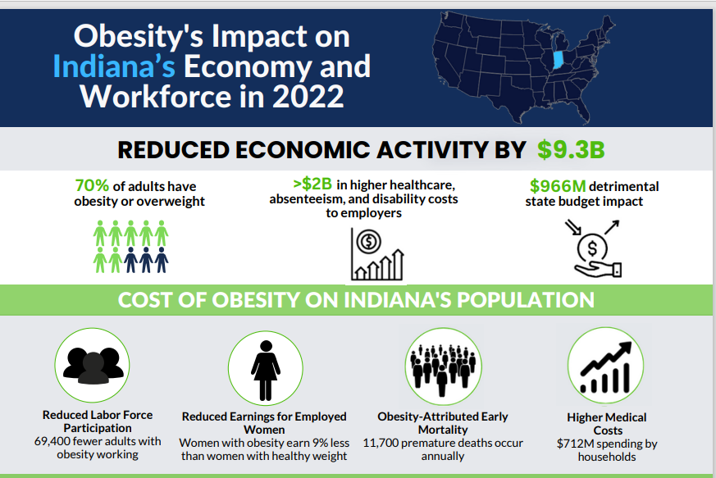
Obesity and Physical Activity
Over 35% of adults in Indiana are obese
30% of adults report insufficient physical activity
Chronic diseases such as diabetes and cardiovascular issues are rising
Notes:
Final Infographic Fact Sheets (wellnessindiana.org)

Slide 9
Smoking, Tobacco Use, and Vaping
According to the CDC, the adult smoking rate in Indiana is 20%
The overall smoking rate in the US is 12.5%, representing those age 18 and over who smoke cigarettes
The adult vaping rate in Indiana is 6%, while the vaping rate among high school students is 22%.
Notes:
Youth E-Cigarette Use Drops to Lowest Level in a Decade | FDA

Slide 10
Smoking, Tobacco Use, and Vaping
Good news on a national level
  The National Youth Tobacco Survey released on September 5, 2024 stated that youth e-cigarette use dropped to the lowest level in a decade
  Half a million fewer US youth reported current use of e-cigarettes in 2024 compared to 2023.
Notes:
Youth E-Cigarette Use Drops to Lowest Level in a Decade | FDA

Slide 11
Indiana Health Metrics
Maternal and Infant Health
Access to Healthcare
Infant mortality rate is higher than the national average
Factors include prenatal care access and smoking during pregnancy
Maternal health challenges, especially in rural areas
Uninsured Rate – Around 8-9% of Indiana’s population is uninsured
Rural areas face disparities in healthcare access
Shortages in healthcare providers contribute to the issue
Notes:
As of preliminary data from 2023, Indiana's infant mortality rate stands at 6.5 deaths per 1,000 live births, a decrease from the 7.2 deaths per 1,000 recorded in the previous year. However, racial disparities remain significant, with the mortality rate for Black infants notably higher at 14.1 deaths per 1,000, compared to 7.9 for Hispanic infants and 5.6 for White infants. Contributing factors include limited access to prenatal care, socioeconomic issues, and higher preterm birth rates among certain populations​(Indiana Public Radio)​(Indiana.gov)​(WFYI Public Media).

Slide 12

Mental Health in Indiana
Indiana ranks 24th in the nation in Mental Health America’s 2024 National Mental Health Rankings
Approximately 1 in 4 adults, or1.26 million people in Indiana have a mental health condition.
Indiana has approximately 530 residents for every one mental health provider.
Each month about 190,000 people in Indiana who experience a mental illness are unable to see a doctor due to costs.
Notes:
Source: MHAI State of Mental Health in America Report released on 7/30/2024.

Slide 13
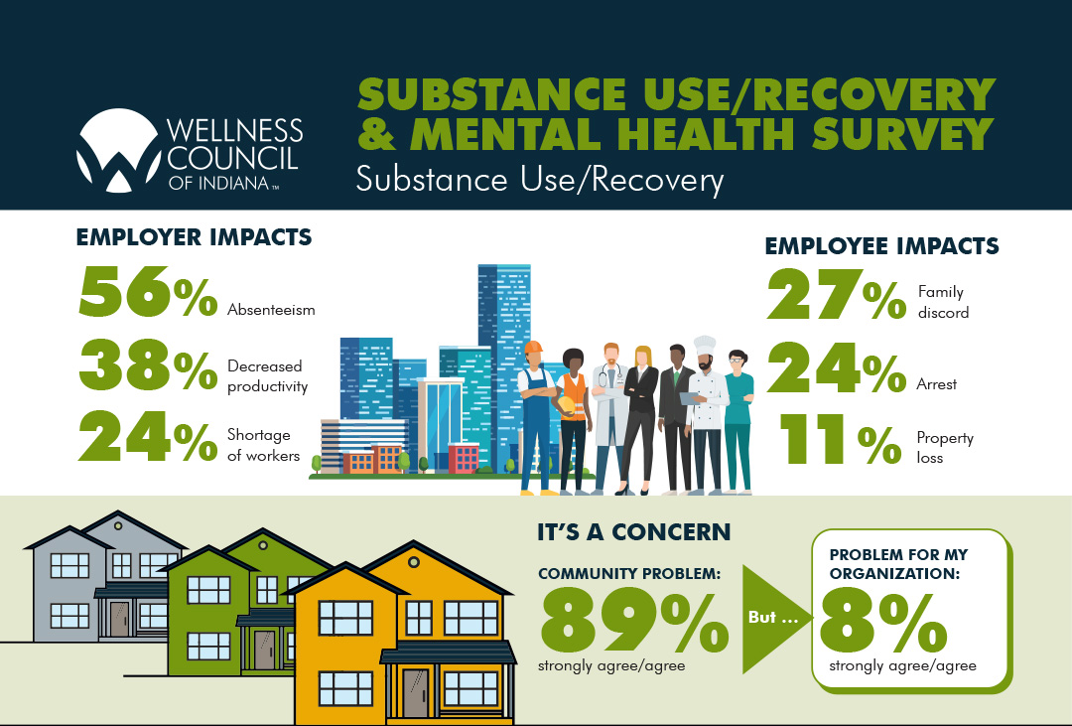
Notes:
Indiana Workplace Substance Use & Recovery Survey 2022 - Wellness Council of Indiana (wellnessindiana.org)
RecoveryMentalHealthSurvey_Infographic 1.pdf
I included all the images from this infographic in slides 12-15 so you can choose which ones to use.

Slide 14
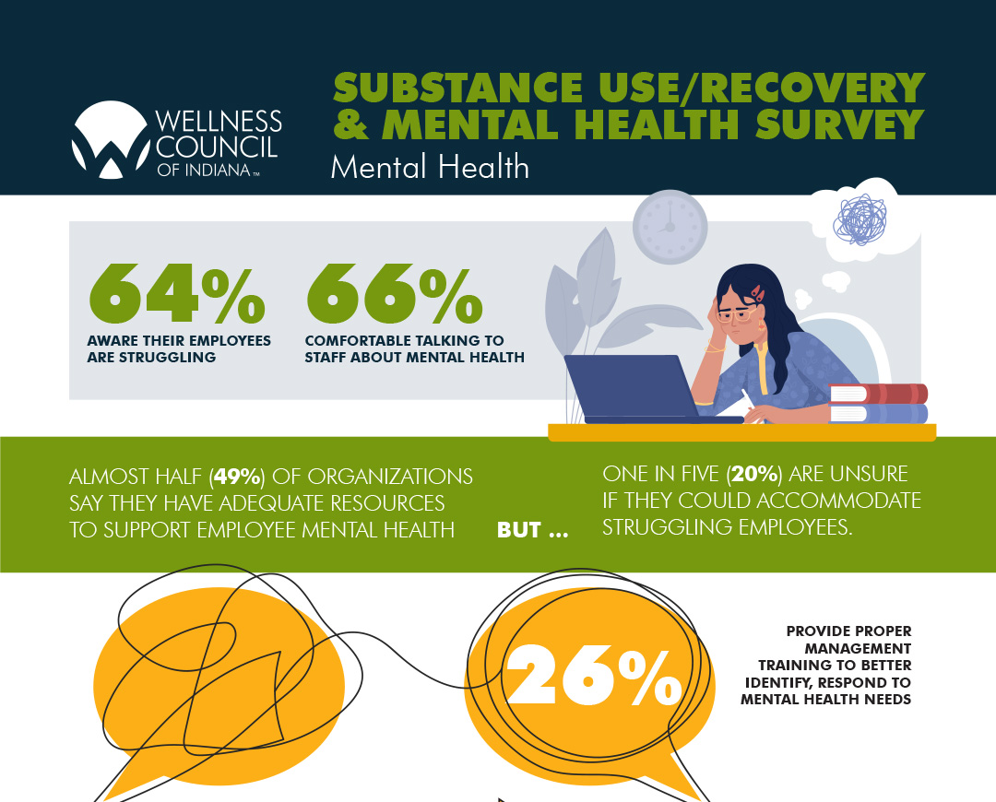

Slide 15
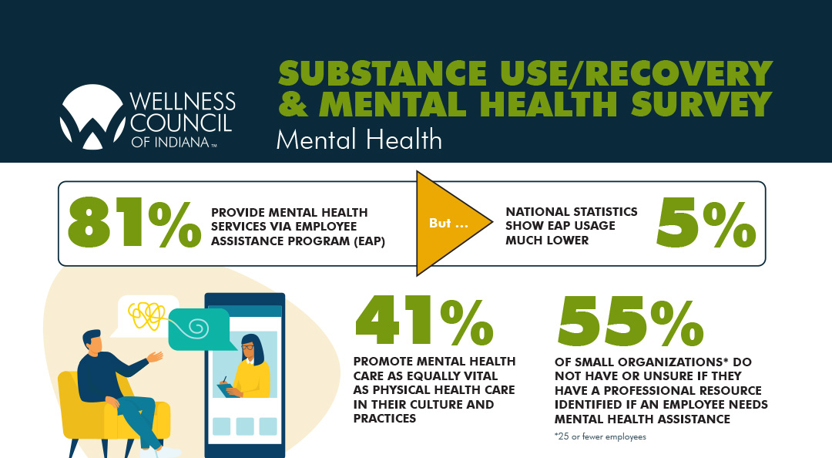

Slide 16
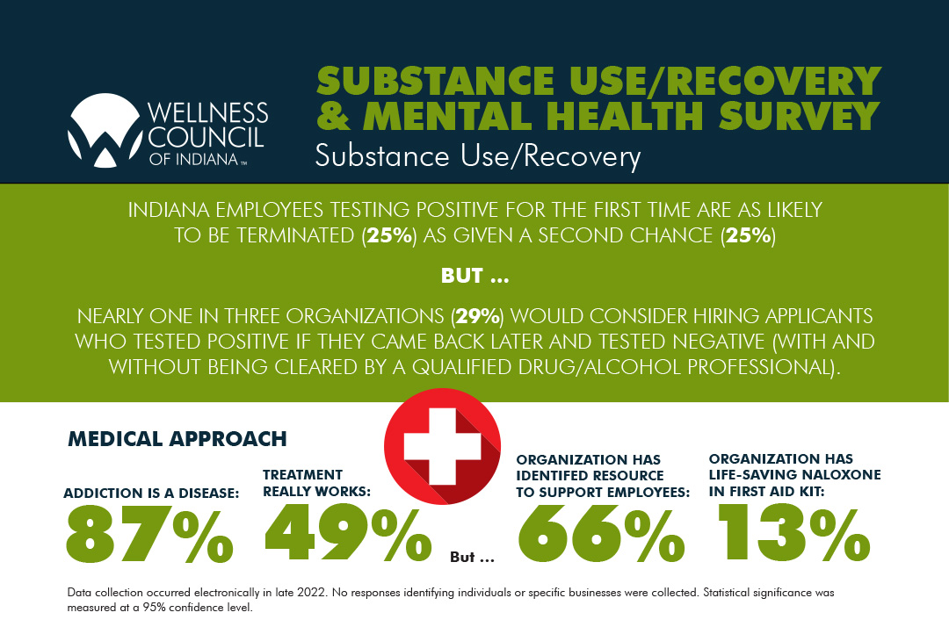

Slide 17
 | Statewide | Jefferson County | Ranking
Obesity | 43.6% | 48.1% | 75th
Infant Mortality | 6.8 per 1000 live births | 7.39 per 1000 live births | 49th
Opioid Overdose | 25.07 | 14.1 | 32nd
Smoking | 21% | 30.9% | 90th
SVI | NA | .6703 | 62nd
Suicide | 15.77 | 12.9 | 11th

Slide 18
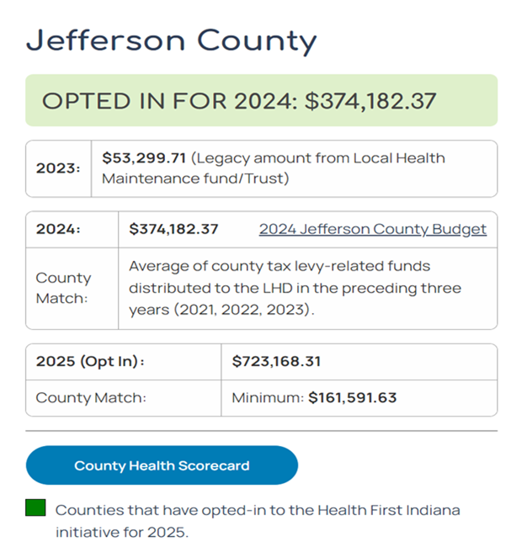
Health First Indiana

Slide 19
The Dimensions of Wellness
Physical Wellness: Care for your body through exercise, nutrition, and rest.
Emotional Wellness: Manage emotions and stress effectively.
Intellectual Wellness: Engage in lifelong learning and mental stimulation.
Social Wellness: Build meaningful connections and communication.

Slide 20
The Dimensions of Wellness
Spiritual Wellness: Explore meaning, values, and purpose in life.
Financial Wellness: Manage finances and plan for stability.
Occupational Wellness: Find satisfaction and balance in work and life.*
Environmental Wellness: Live in harmony with the environment.*

Slide 21
Why Employee Wellbeing Matters
Increased Productivity
Reduced Absenteeism
Higher Employee Engagement
Improved Mental Health
Lower Healthcare Costs

Slide 22
Common Workplace Wellness Challenges
Stress and Burnout
Poor Work-Life Balance
Sedentary Lifestyles
Lack of Employee Engagement in Wellness Programs
Mental Health Stigma

Slide 23
Creating a Wellness Culture
Leadership Buy-In and Support
Foster Open Communication
Promote Mental Health Awareness
Encourage Positive Relationships
Flexibility and Work-Life Balance

Slide 24
Low Cost / No Cost Workplace Wellness Strategies

Slide 25
Creating a Culture of Health
Assess your current worksite
Accommodations
Workplace policies
Promote your efforts
Notes:
Do you have a supportive culture of health in your organization? Supporting healthier employee choices does not have to be dramatic or burdensome to be impactful.
Identify and determine opportunities for promoting good health at your worksite.
Use strategies and tools to implement policies, environmental supports and activities at your worksite to provide your employees with opportunities to make healthy choices easier.
In an effort to foster healthier employees, many employers choose to promote a culture of health and well-being by changing worksite policies.
Ensure employees are aware of your efforts; create opportunities for employees to participate.

Slide 26

Assess your Worksite Needs
Employee interest survey- solicits employee involvement and approval and plays significant role in helping launch a successful health initiative.
Workplace assessment- designed to examine aspects of your worksite environment as it relates to supporting healthy behaviors.
Vending assessment- designed to assess the number of healthier food and beverage choices available in the vending machines at your business.
Notes:
Assessments can help you understand the needs and interests of your workforce.
Take advantage of FREE resources available through the Indiana Department of Health, such as this Healthy Worksite Toolkit, available on the IDOH website at https://www.in.gov/health/dnpa/files/16_Worksite-toolkit-web-final.pdf
16_Worksite-toolkit-web-final.pdf
There are several ways to evaluate your worksite and assess employee needs. Examples surveys include: employee interest, Risk Test, worksite environment, and food availability (such as vending machine assessments).
Employee interest survey-read from slide
EXAMPLE survey questions located in Working Well Toolkit.
Workplace assessment- Your worksite environment can act as either a barrier or a support for healthy employee opportunities. An environmental assessment will help determine in which category your current worksite fits. It can also identify areas where you can improve your worksite to create those needed supports.
EXAMPLE workplace assessment in Working Well Toolkit.
Vending assessment-The more healthy choices available, the more likely your employees will choose them. You can use the results from this assessment to develop a strategy to increase the availability of healthier choices
EXAMPLE vending assessment in Working Well Toolkit.

Slide 27

Accommodations and Policies
  Flexible Workplaces
  Hybrid work schedules
  Part-time work hours
  Sick Leave/MH days
  Breaks
  Other policies
Notes:
The workplace has an outsized impact on mental health of employees. That’s because most of us spend more time working than on any other activity apart from sleeping. Jobs can affect the foundations of our mental wellness, like financial stability, feelings of self-worth and meaningful relationships. Employers can help their workplace culture by acknowledging this impact.
Leaders have the responsibility to help reduce the sources of stress within the workplace. Therefore, that may mean looking at the management practices, design of the work and the physical and social environments of the organization.
This may mean redesigning work schedules;
Flexible workplace : Hybrid work schedules (office/work from home), flexible start/end times, work “make-up”
Treat time off for mental health reasons the same way you do for other sick leave. Consider including specific mental health days in employee benefits. Modeling a supportive workplace culture is key to building trust and laying the foundation for a supportive work environment. Specifically, when CEOs, supervisors and managers take vacation time, their own mental health days or maintain a work-life balance contribute to the culture that values mental health.
Other : Think about other environmental factors or social factors that could influence a person’s mental health. For example, ergonomics of the workstation as well as considering beverage/food at workstations, etc.

Slide 28
Free or Low-Cost Resources
Indiana Department of Health
Centers for Disease Control and Prevention (CDC)
Awareness Month Challenges
Indiana 211
Mental Health Resources:
  EAP
  988 Suicide and Crisis Lifeline
  SAMSHA – Substance Abuse and Mental Health Services Administration
Tobacco Cessation Resources
  Quit Now Indiana
  Smokefree.gov
  TheTruth.com/Quit
Medical Insurance Carrier
  Anthem (Sydney app), UMR, UHC, and others provide a library of wellbeing resources
Notes:
IDOH offers the Healthy Worksite Toolkit discussed earlier, as well as an employer-based training program called Work@Health . Health: DNPA: Workplace Wellness (in.gov)
CDC offers a Worksite Health Scorecard to provide guidance on evidence-based strategies. CDC - Worksite Health ScoreCard
Awareness Month calendar:
Annual Health Observances | NIAMS (nih.gov)
National Health Observances | health.gov
Many organizations offer free materials for employers to promote the awareness months. Google the awareness month to find materials ready for distribution. National Health Observances | health.gov

Slide 29
Low-Cost Communication Considerations
Develop a communication plan, and include these key elements
Goals (SMART)
Objectives
Target Audience
Strategies
Key Messages
Communication channels
Budget
Marketing Tips
Build a wellness brand
Launch your program
Leverage special events
Review and evaluate
Identify available resources
Current programs or in-house resources
Internal leadership to help promote
Vendor partners
Outside organization resources

Slide 30
Promote Your Efforts
Employees are key stakeholders and should be informed of the program’s purpose, actions taken, the reasons for and results of those actions.
  Materials and messaging should be culturally competent.
  Brand the health strategy, including logo
  Define the target audience
  Use variety of messaging channels:
    Meetings
    Flyers, brochures or posters
    Intranet announcements
    Email updates
    Employee newsletter
    Bulletin boards
Notes:
Promoting your worksite health efforts plays an important role in whether or not your employees take advantage of the opportunities you are creating.
Increase employee’s knowledge and awareness of health issue/problem or solution
Successful implementation of the workplace health program depends, in large part, on how the employees react to the changes. Even the slightest misunderstanding can result in major disruptions. Thus, regular and consistent communication is a vital component of the overall program and fosters an organizational commitment to employee health. Consistency comes from repetition and uniform presentation from all levels of the organization and over time will create a culture of health.
Materials and messages should be culturally competent, that is, understood by and applicable to individuals from different cultures, race or ethnicities, or languages; relevant, and at a sufficient level of health literacy
Brand the health strategy, including logo
Define the target audience
Use variety of message channels
Recognize and celebrate successes

Slide 31
Meaningful Engagement with Remote Employees
Notes:
We’ve discussed all the programs and strategies we can put in place. Now let’s explore connecting employees to those resources!

Slide 32
Remote Work Statistics
43% of US employees work remotely at least some of the time according to Gallup
In 2023 the US Surgeon General reported that Americans are in the midst of an “epidemic of loneliness”
62% of American workers report feeling heightened levels of loneliness.
Notes:
Tools for Engaging and Managing Remote Employees - Wellness Council of Indiana (wellnessindiana.org)
Health Action Alliance

Slide 33
Connecting with Remote Employees
Virtual Coffee Breaks
  Scheduled breaks to discuss non-work topics
Online Games or Challenges
  Encourage teamwork and collaboration
Regular Check-ins
  1:1 meetings to discuss work and personal well-being
Recognition Programs
  Celebrate achievements publicly
Personal Updates
  Start meetings with opportunities for employees to share personal updates so team members can learn more about each other

Slide 34
Fostering Community at Work
Make social connection a strategic priority at all levels
  Establish cross-team collaboration and prioritize teamwork
Train and empower leaders to promote connection in the workplace
  Provide managers with tools to assess loneliness in workers:
    UCLA Loneliness Scale or the Belonging Barometer
Formalize an employee mentorship program to encourage building connections
Notes:
Health Action Alliance

Slide 35
Fostering Community at Work
Establish affinity groups for employees to connect with coworkers who share their identities and experiences
Consider utilizing online collaboration tools such as Slack, Microsoft Teams, etc. to foster these communications remotely.
Host company-wide volunteer days to encourage employees to connect with their local community

Slide 36
The Role of Data in Wellness Programming
Identifies Employee Needs:
  Surveys, health screenings, and feedback provide insight into key wellness issues.
Measures Effectiveness:
  Track metrics like participation, health outcomes, and employee satisfaction.
Informs Decision-Making:
  Data-driven decisions ensure resources are allocated effectively.

Slide 37
Emerging Trends
Mental Health
Financial Health
Maternal Health
Obesity
Aging Workforce/Generational Needs
Workplace Ergonomics

Slide 38
Wrap up and Summary
Indiana’s health metrics show room for improvement in the areas of obesity and physical activity, tobacco use, maternal / infant health, access to healthcare, and mental health.
Cost effective ways to approach worksite wellbeing include: building a culture of health, adjusting company policies, and taking advantage of resources available through agencies such as IDOH and CDC.
Be creative in efforts to connect with remote employees. If employees are local, schedule regular in-person social events. Offering online challenges, virtual coffee hours, and recognition programs can also help remote employees feel more connected.

Slide 39
Cultivating a Healthy Workplace:
The Key to Healthier Employees
Jennifer Pferrer, Executive Director
Wellness Council of Indiana
Indiana Chamber of Commerce
jpferrer@indianachamber.com

Slide 40
Thank you!

