Slide 1
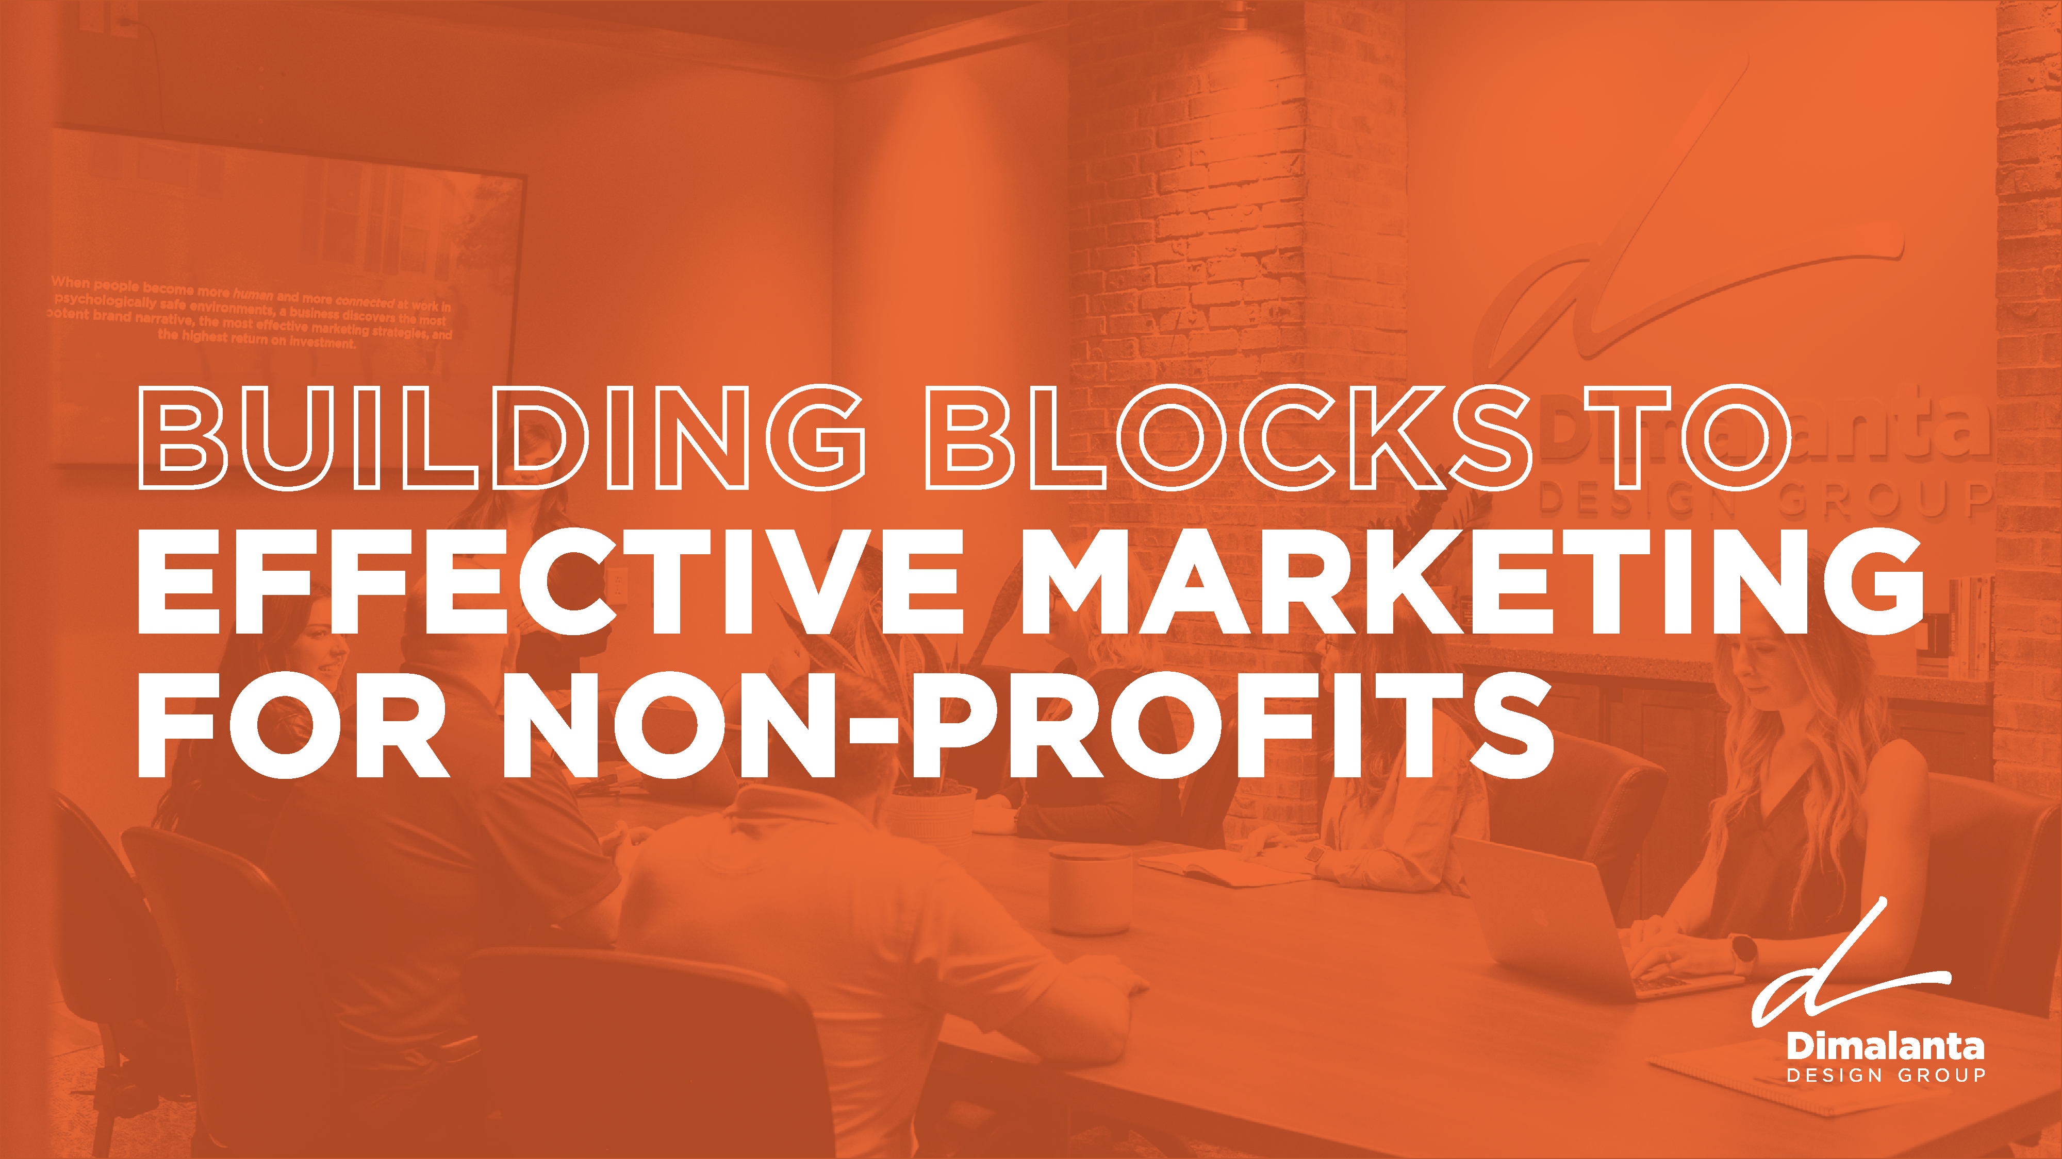

Slide 2
UNDERSTANDING
MARKETING BASICS
Definition of Marketing
  It's all about "IT"
  Marketing as the process of creating, communicating, and delivering value.
Importance of Marketing for Non-Profits
  Building awareness.
  Engaging donors, volunteers, and service users.
Key Components of Marketing
  4 Ps

Slide 3
IDENTIFYING YOUR AUDIENCE
Segmentation
  Breaking down your audience into manageable groups: donors, volunteers, and service users.
Targeting
  Focusing on specific segments for more effective communication.
Creating Personas
  Developing detailed profiles for your ideal donors, volunteers, and service users.
  Example: Demographics, interests, motivations.

Slide 4
CRAFTING YOUR MESSAGE
Value Proposition
  What makes your non-profit unique?
  Why should people care about your cause?
Storytelling
  Using stories to connect emotionally with your audience.
  Examples of impactful stories.
Call to Action
  Clear, compelling actions you want your audience to take.

Slide 5
CHOOSING THE RIGHT CHANNELS
Overview of Marketing Channels
  Online: Website, social media, email marketing.
  Offline: Events, print materials, community outreach.
Digital Marketing Basics
  Importance of a user-friendly website.
  Utilizing social media platforms effectively.
  Email marketing for direct communication.
Community Engagement
  Local events and partnerships.
  Networking and word-of-mouth.

Slide 6
MEASURING SUCCESS
Key Performance Indicators (KPIs)
  Examples: Donation amounts, volunteer sign-ups, and event attendance.
Tools for Measurement
  Google Analytics, social media insights, email marketing reports.
Adjusting Strategies Based on Data
  Analyzing what works and what doesn't.
  Making data-driven decisions.

Slide 7
CONCLUSION AND Q&A
Final Thoughts
  Consistency is key.
  Be authentic and transparent.
  Keep learning and adapting.

Slide 8
Learn more at: dimalantadesigngroup.com

