Slide 1
Thank you for coming!
Please scan the QR code and tell us what you would like to get out of today
Join at slido.com
#4222 094
Notes:
MH
These instructions should be happening as people are arriving.
Please take a moment to fill out the survey so we can try our best to touch on what is requested!
Bathrooms are WHERE
Help yourself to food
Make sure you signed in and grabbed your name tag on the way in

Slide 2
Notes:
MH
Introduce staff and grants Comm members in attendance
We started the Legacy Grants series to be transparent and available to our prospective grantees. We hope you leave here today knowing that we are here to support you in any way we can!
The plan is to go through the presentation that will explain our history, what to do if you’re considering applying for funding, the application, and the funding, We will stop for questions along the way. After the presentation we are going to split up into breakout rooms with the program managers and CEO. This will be an opportunity to ask more specific questions you might have.

Slide 3
Thank you for coming!
Please scan the QR code and tell us what you would like to get out of today
Join at slido.com
#4222 094
Notes:
MH
Now that I have introduced the event and purpose, we want to give you another opportunity to tell us what you want out of the day!
Please take a moment to fill out the survey if you haven’t already so we can try our best to touch on what is requested!
OTHERS WILL BE ABLE TO SEE YOUR RESPONSES BUT THEY WILL BE ANONYMUS

Slide 4
About
Bethany Legacy Foundation
Formed out of the King’s Daughters’ Health in Madison, Bethany Circle of King’s Daughters and Sons, Bethany Legacy Foundation (BLF) is a non-profit health foundation established in 2022 dedicated to the health and wellness of Jefferson County residents.
Working to make Jefferson County the healthiest place in the world.
1896
2022
Notes:
DA
How we formed
Our mission/vision
9 person board which you can find on our website
Our connection to the hospital?? (idk if we want to do this but if we did, I could see it being something like "although we were formed from the change of ownership of the hospital, we are now completely independent of them")

Slide 5
Our Philosophy
Trust Based Philanthropy
Trust-based philanthropy is about redistributing power—systemically, organizationally, and interpersonally—in service of a healthier and more equitable nonprofit sector.
Trust In Action
We are dedicated to the trust-based philanthropy approach. Here are some ways we are implementing it:
Multi-year unrestricted funding
Doing the homework
Simplifying and streamlining paperwork
Being transparent and responsive
Solicit and act on feedback
Offer support beyond the check (like the Learning Labs)
Notes:
DA
Explanation of TBP and examples of how it is showing up in our work.
mention the survey of past grant recipients

Slide 6
2024 Strategic Focus
More details at: https: https://bethanylegacy.org/strategic-focus/
Notes:
DA
Explanation of the pillars

Slide 7
2024 Strategic Focus
More details at: https: https://bethanylegacy.org/strategic-focus/
Notes:
DA
This year we are excited to announce our focus on mental health and substance use.
We know that mental health is not only connected but often the root cause of substance use disorder.
we will use our resources strategically to primarily fund work and organizations focused on improving mental health and providing substance abuse support for the youth, adults, seniors, and workforce of Jefferson County, IN.

Slide 8
Questions
As we go through the presentation feel free to raise your hand or fill out this survey!
Join at slido.com
#4222 094
Notes:
MH
Introduce the question asking
Others will be able to see your questions
Can raise your hand throughout and we will stop
We will stop after each section for questions
Project specific ideas are best for the breakouts.
Please scan this QR code now and use it whenever you have questions throughout! You may also raise your hand at any moment, but we wanted to provide an anonymous virtual version as well to make things run smoothly!

Slide 9
thinking of applying?
Notes:
MH
Now that we have talked about our history and strategic focus Ronnie is going to talk about our current guidelines and funding priorities.

Slide 10
2024 Grant Guidelines
Eligibility
BLF awards grants to 501(c)(3) not-for-profit organizations, churches, state-accredited schools, and government entities.
Grant-funded activities must serve residents of Jefferson County, Indiana.
Amenities funded by BLF must be available to the general public, not restricted to a limited group(s) (e.g. parks, schools, playgrounds, pools etc.).
Grant requests should have a direct impact on mental health or substance use disorder.
Bethany Legacy will not fund
Organizations, programs, or projects that discriminate in any way.
Lobbying or political campaigns.
Conference or event sponsorships.
Projects that use BLF grant funds to replace existing funding sources.
Real estate purchases with Bethany Legacy as the sole funder.
Direct grants to individuals.
More details at: https://bethanylegacy.org/grant-making/
Notes:
RW
some of these are legal requirements
Mention fiscal sponsors
Organizations can always reach out if they aren’t sure if their organization or request is eligible

Slide 11
Funding Priorities
Important Attributes of the Grant Proposal - Please note BLF will not fund all applications it receives. All applications will be assessed and scored for:
Evidence-Based Practice or Supporting Data
Systems Impact Potential
Prevention
Innovation
Service Enhancement
In addition, we will prioritize proposals that have these factors:
Collaboration
Community Engagement
Comprehensive Project Budget
Leveraged Funding
Multiple Quotes (if using vendors or consultants)
Funding Sustainability
Plan for Project Assessment and Evaluation
More details at: https://bethanylegacy.org/grant-making/
Notes:
RW

Slide 12
Notes:
MH
After some feedback from our 2023 grant recipients, we wanted to be transparent about our current funding calendar.
This calendar reflects the dates that the pre-application and application need to be submitted by in order to receive a funding notification in July, September, and November.
Pre app is new, but we will talk about it in depth later. You can submit it anytime you have an idea and are thinking about applying. You do not need to wait for the proper stage of this chart because the portal will not close between each stage.
This timing is subject to change based on the amount of funding requests and projects we fund.
Between every step of the way there are also internal steps our staff will be working on. These time up with the grants committee and board meeting dates.

Slide 13
Journey of a Grant
Notes:
MH
This diagram shows the journey of a grant.
go through each step briefly
QUESTIONS PART: We are building our knowledge because staff is the one that presents the grant. Applicants typically hear from us regularly through the whole process so make sure you provide correct contact information.

Slide 14
Questions
As we go through the presentation feel free to raise your hand or fill out this survey!
Join at slido.com
#4222 094
Notes:
MH
At this point we would like to pause to see if anyone has any questions and provide the link again if anyone prefers to send questions that way.
We will answer questions as time allows but if we receive a lot we might not be able to get to them all and will be online on the learning labs.

Slide 15
the application
Notes:
MH
We are able to break the journey of a grant up into two sections. The application and the approval. Now we will discuss everything that goes into applying for Bethany Legacy funding.

Slide 16
Grantmaking Portal
More details at: https://bethanylegacy.org
Notes:
MH
In order to get to our application you will need to go to bethanylegacy.org and click on "apply for a grant" at the top right

Slide 17
Account Sign In
Notes:
MH
Once you click on that you will be routed to our online grantmaking portal. You will then be prompted to sign in or create an account.
In some cases, we can create an account for you.

Slide 18
Account Sign In
Organization Information:
Organization Name
EIN / Tax ID
Telephone Number
Address 1
City, State, Postal Code
Individual Information:
First Name and Last Name
Business Title
Email / Username
Email / Username Confirmation
Telephone Number
Address 1
City, State, Postal Code
Executive Leadership Information:
First Name and Last Name
Business Title
Email
Notes:
MH
If this is your first time signing in you will need to create an account. To do so you will be asked some basic information about your organization and contact information which is listed here.
If you have already created an account please check all of this information and make sure it is all up to date!

Slide 19
Application
ORG NAME
Notes:
MH
Once you have signed in or created your account you will land on the “apply” tab. Here you will be able to see any active grant applications through Bethany Legacy. In order to start the process click “apply”.

Slide 20
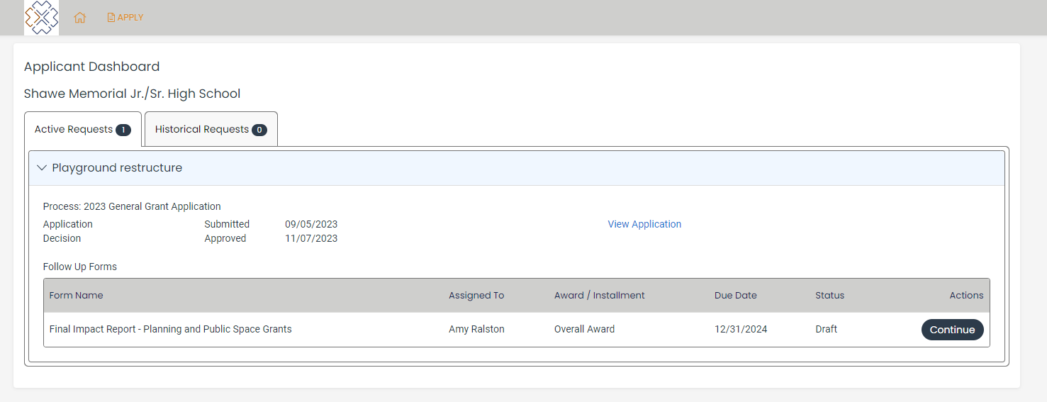
Applicant Dashboard
ORG NAME
PROJECT NAME
Notes:
MH
Once you start a pre-application it will be located in your dashboard under “active requests”. This is also where you will see active impact reports and their due dates.

Slide 21
Pre-Application
This year, a new pre-application process has been introduced to confirm that the request complies with the guidelines and requirements before the grant seeker proceeds with a full application.
This change will lead to:
Quicker eligibility verifications
Increased coaching and support
Improved efficiency
If the request meets the eligibility criteria and funding priorities, the organization will be asked to submit a complete application. Responses from the pre-application will be transferred to the full application to avoid duplicate efforts and can be adjusted during that stage.
Notes:
MH
This year we ask all grant seekers to submit a pre-application. This will allow staff to perform faster eligibility verifications, have improved efficiency, and provide increased coaching. We will be able to let you know if we will need quotes, letters of support, fiscal sponsorship agreements, and much more.
This will stop people from spending time completing a full application if their organization or request does not match our eligibility requirements and funding priorities.
Answers from the pre app will be pulled into the application form and they will be ablet to be edited.
If you are approved to do an application, you will be asked to submit a budget in the application.

Slide 22
Budget Templates
We require a detailed budget for the whole project that outlines all expenses including overhead AND all confirmed and requested sources of income for projects, including the requested funding from Bethany Legacy.
We expect budgets to
Be clear
Be detailed
Outline all expenses and revenue (such as other sources of funding)
And may include reasonable indirect or overhead costs
Although it is not mandatory, we've designed several budget templates for your convenience!
Templates can be found here: https://bethanylegacy.org/grant-making/
Notes:
MH
Our application requires you to submit a clear and detailed budget that outlines all expenses and revenue of the request.
This should include the project as a whole not just the request from Bethany Legacy.
In an attempt to ease the burden of a budget we have created budget templates you are welcome to use.

Slide 23
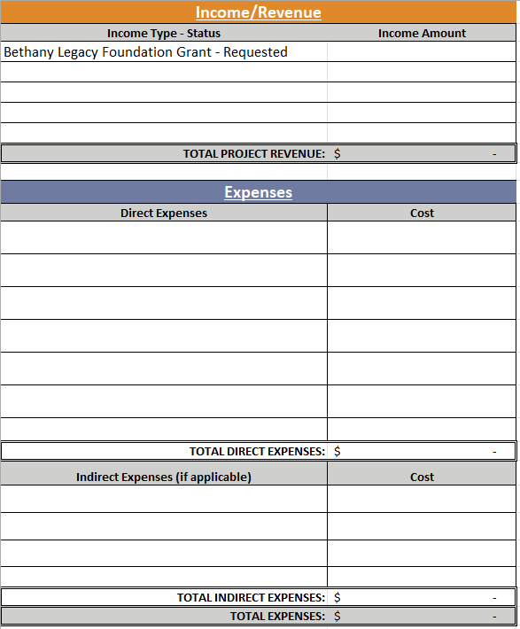
Notes:
We want to see the whole picture! If you have a 100,000 project but you are requesting 30,000 from us we want to see the 100,000 budget.

Slide 24
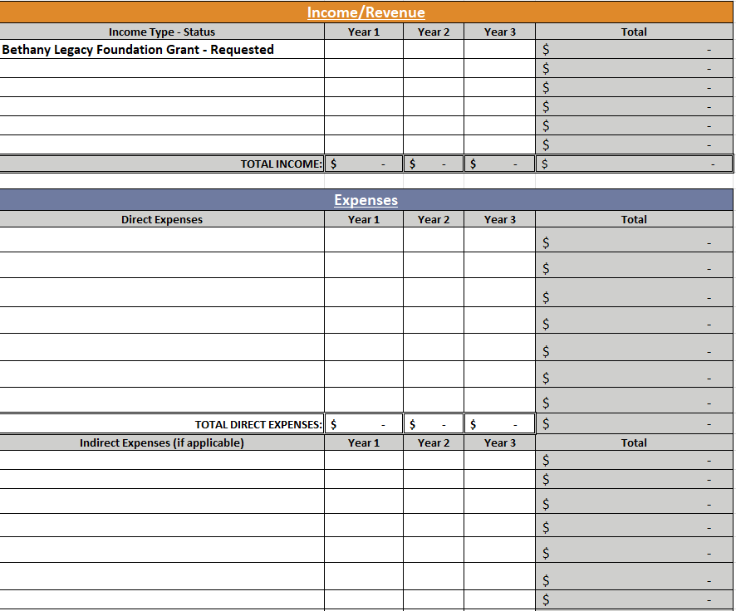
Notes:
You can edit them to meet your needs best!
Although the budget is required, using our templates are not. If you have something that works better for you please use it! Just make sure it has everything listed above.

Slide 25
Questions
As we go through the presentation feel free to raise your hand or fill out this survey!
Join at slido.com
#4222 094
Notes:
MH
At this point we would like to pause to see if anyone has any questions and provide the link again if anyone prefers to send questions that way.

Slide 26
the approval
Notes:
MH
Now that you know all about the application process Ronnie will discuss what goes into receiving Bethany Legacy funding.

Slide 27
Steps After Approval
Complete the steps in the approval email sent by a Program Manager:
Award letter
Grant agreement to be signed and completed by recipient
Marketing instructions
Next steps
Complete the direct deposit steps sent by the Operations Director:
Sign the direct deposit agreement
Provide a pre-printed check or a bank statement with the account number and bank’s routing number listed
Co create the reporting points and catch-up schedule with your assigned Program Manager
Notes:
RW
Walkthrough the process of getting called, getting the email, getting passed off to angie, and catch up/reporting
preferred banking information be dropped off or mailed

Slide 28
Catch-ups
Bethany Legacy grant recipients have regular catch-ups with the Program Manager assigned to their grant.
These are casual conversations over lunch, coffee, phone, or email regarding how the grant is going and an overall check in with the organization. We see these as learning opportunities for us to best serve Jefferson County.
Depending on the grant and organization the frequency can be monthly, bimonthly, or quarterly.
How is it going?
Notes:
RW
Connecting dots – exchange information and connect to other work, projects or people
How is it going?
important for us to learn about what isn't going well and who is being underserved
Mention that these are casual and should not cause stress. And can be rescheduled if necessary

Slide 29
Impact Reports
Bethany Legacy grant recipients will need to submit an impact report at the conclusion of their grant. If it is a multi year grant the recipient is expected to submit a report each year before the next payment is sent.
This is a co created form using information you ideally already collect.
Things we like to know:
Data
Key takeaways
Other funding
Pictures
How did it go?
Notes:
RW
Shouldn’t feel like a traditional report, we’re meeting you where you are and using only what you already collect
Cocreated with organizations after they receive the grant but can be changed if necessary
We are flexible
reports are for shared learning
Report on whole project, just like budget is for full project
important for us to learn about what isn't going well and who is being underserved
How did it go?

Slide 30
Questions
As we go through the presentation feel free to raise your hand or fill out this survey!
Join at slido.com
#4222 094
Notes:
MH
At this point we would like to pause to see if anyone has any questions and provide the link again if anyone prefers to send questions that way.

Slide 31
Grant seeker Resources
Learning Labs: https://bethanylegacy.org/legacy-learning-labs/
Strategic Focus: https://bethanylegacy.org/strategic-focus/
Timeline and Guidelines: https://bethanylegacy.org/grant-making/
Budget Templates: https://bethanylegacy.org/budget-templates/
Application Portal: https://www.grantinterface.com/Home/Logon?urlkey=blf
Contact Us:
Morgan Hamilton, Program Manager
morgan.hamilton@bethanylegacy.org
812.916.4392
Notes:
MH
Can contact Morgan but might be shifted to Ronnie based on project and availability.
If you already have worked with Ronnie please feel free to reach out to her directly!

Slide 32
capacity-building topics for prospective grantees
We believe our community thrives when organizations have the resources they need to focus on their mission. Our goal is to listen to you–the changemakers of Jefferson County– and strengthen the access to resources you want and need.
Throughout the Legacy Links sessions, Bethany Legacy Foundation aims to create an environment that provides resources, speakers, networking, and collaboration opportunities, to fuel the work of our local prospective grantees. These offerings will be tailored to meet the specific needs of the community based on their input.
tentative next date: June 27, 2024
Notes:
MH
We believe our community thrives when organizations have the resources they need to focus on their mission. The second arm of the Learning Labs will be our Legacy Links series which will create an environment that provides resources, speakers, networking, and collaboration.
This will be co created with you all – the changemakers in order for us to bring things that are helpful and needed to you! Because we haven’t gotten to your input just yet we don’t have an exact date, but we are hoping for June 27th

Slide 33
Legacy Links Series Topics
Please scan the QR code to tell us what topics you would like covered at the Legacy Links sessions.
Join at slido.com
#4222 094
Notes:
MH
In order for us to move forward with the next steps please scan this link to suggest topic and or speakers for future legacy links sessions! Once we receive feedback we can compile the topics frequently requested and find speakers and resources in that realm!
EXAMPLES
Thank you for coming! Now if you would like to join us for breakout sessions we will move to that.
Dora = Orange
Ronnie = Green
Morgan = Blue

